Slide 1
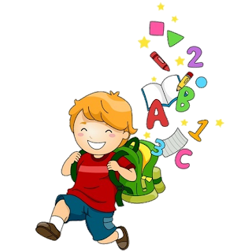
5
Unit 1

Slide 2
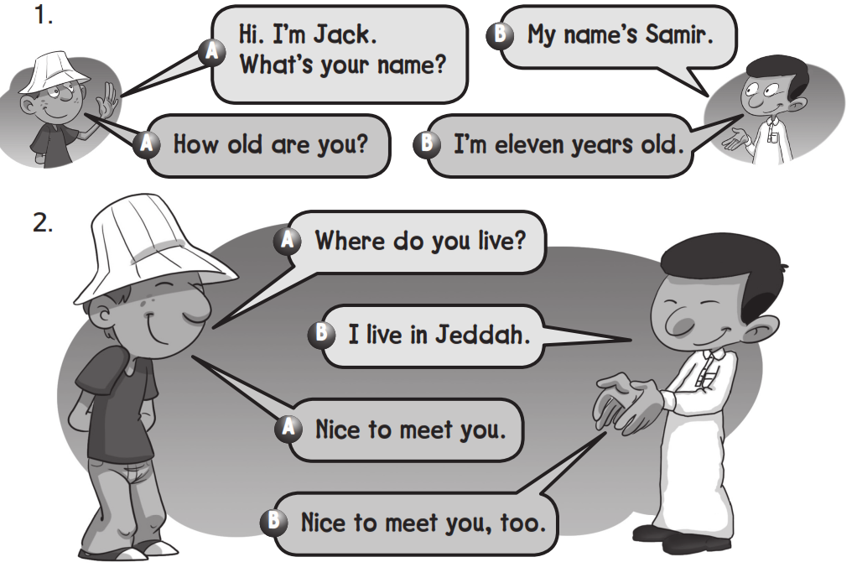
Work book
It’s Nice to meet You

Slide 3
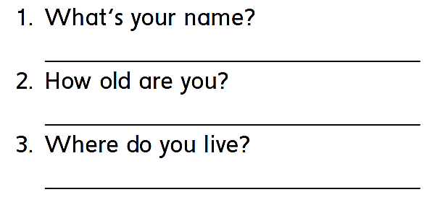
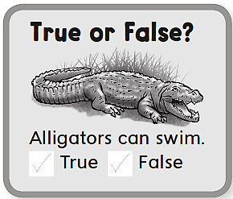
Work book
It’s Nice to meet You
My name is …………………
I’m 12 years old
I live in ………………

Slide 4
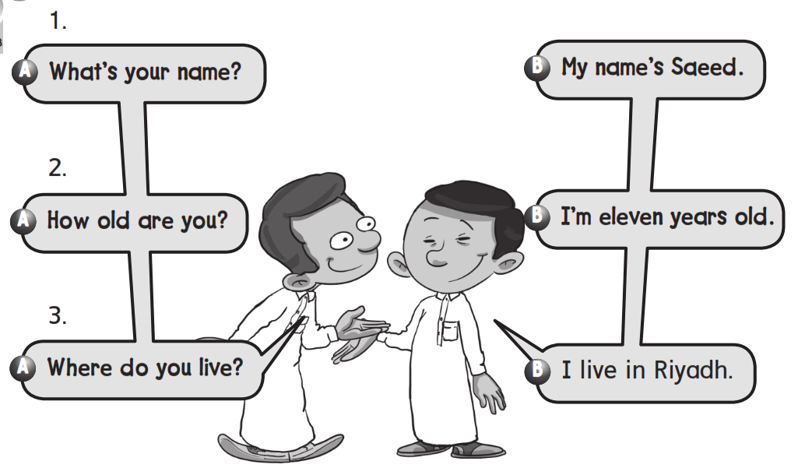
Work book
It’s Nice to meet You

Slide 5
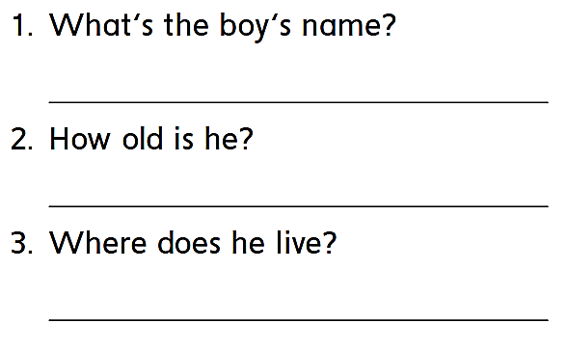
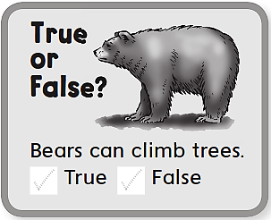
Work book
It’s Nice to meet You
His name is Saeed
He is 11 years old
He lives in Riyadh

Slide 6
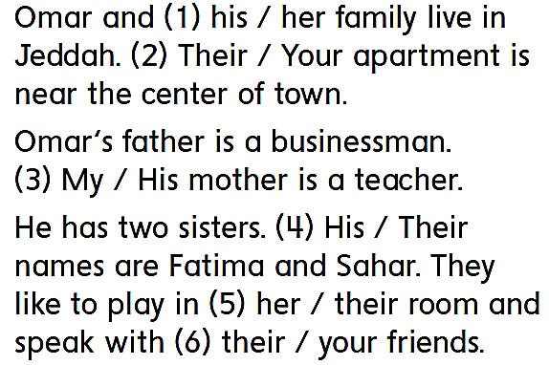
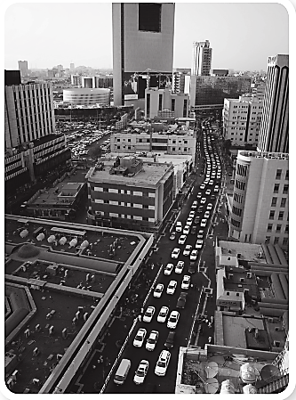
Work book
It’s Nice to meet You

Slide 7
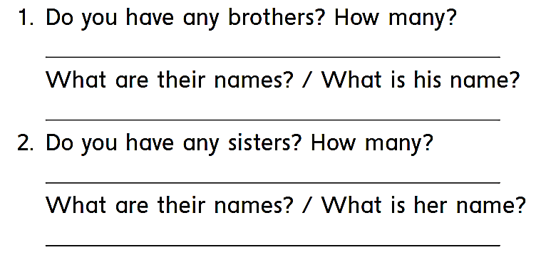
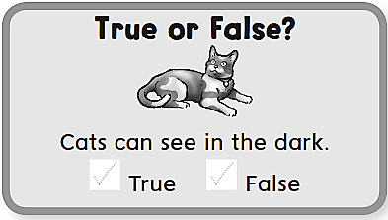
Work book
It’s Nice to meet You

Slide 8
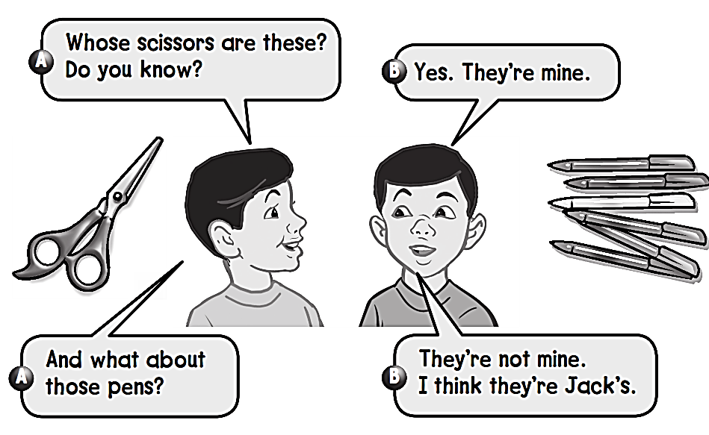
Work book
It’s Nice to meet You

Slide 9
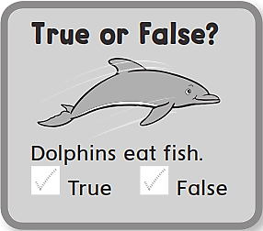
Work book
It’s Nice to meet You
Whose pens are these ? Do you know ?
Yes , they’re mine
And what about those erasers ?
They’re not mine
I think they’re Faisal’s

Slide 10
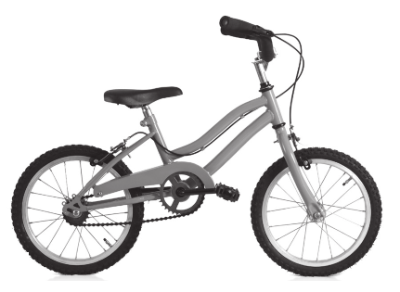
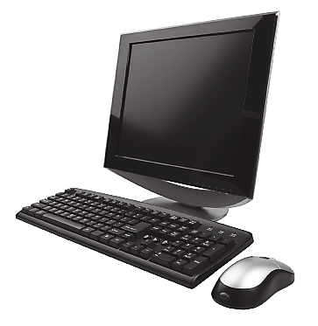
Work book
It’s Nice to meet You

Slide 11
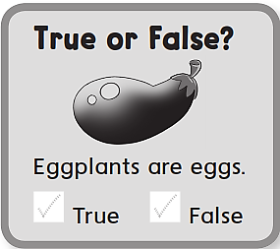
Work book
It’s Nice to meet You
I have a p
You have an e
He has an n
If you have a c , an i , an l
Then we have all the letters to write pencil

Slide 12
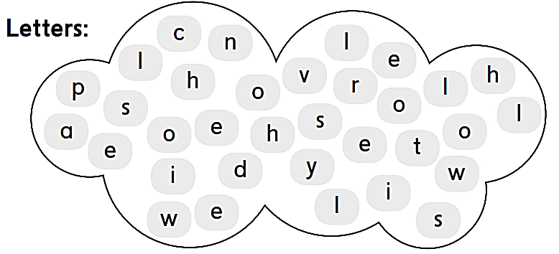
Work book
It’s Nice to meet You

Slide 13
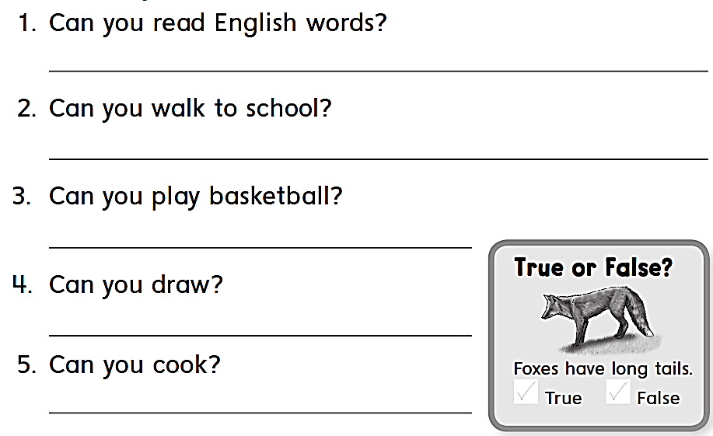
Work book
It’s Nice to meet You
Yes , I can .
No , I can’t
Yes , I can .
Yes , I can .
No , I cant

Slide 14
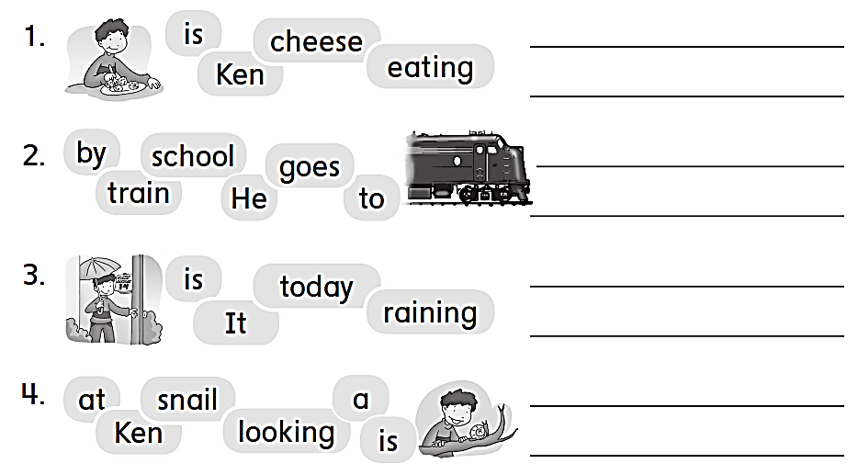
Work book
It’s Nice to meet You
Ken is eating cheese
He goes school by to train
It is raining today
Ken is looking at a snail

Slide 15
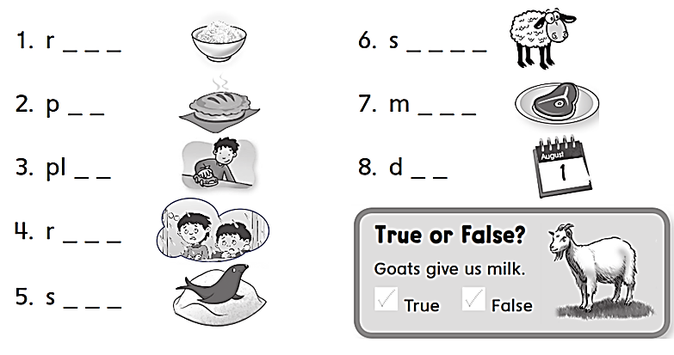
Work book
It’s Nice to meet You
i c e
h e e p
i e
e a t
a y
a y
a i n
w i m

Slide 16
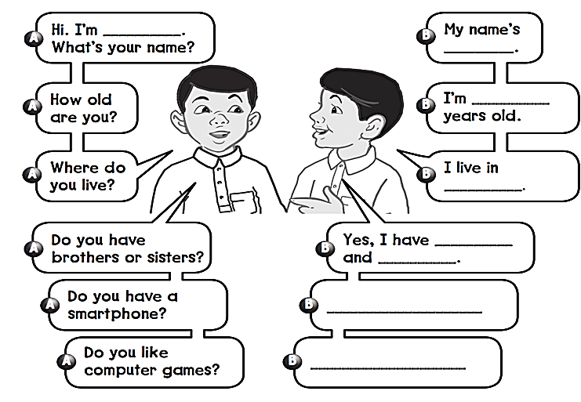
Workbook
It’s Nice to meet You
Imad
Sayid
12
Najran
2 brothers
3 sisters
Yes , I do
Yes , I do

Slide 17
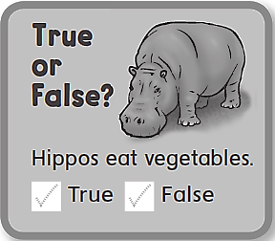
Work book
It’s Nice to meet You
Do you have a social media account ?
What’s your account ?

